Slide 1
MONOD: Methylation Haplotype in non-invasive Cancer Diagnosis
Shicheng Guo @ Zhang Lab
Oct 12 2015
Notes:
Hello, everyone, today I will introduce the progress of the mond project which is shorted for Methylation Haplotype in non-invasive Cancer Diagnosis

Slide 2
Previous review
Aim: Methylation Biomarkers for non-invasive cancer diagnosis or tracking
Methylation block is genomic region in which the methylation correlation between adjacent CpG loci were relatively higher compared with the expectation.
Methylation block is a conservative phenomena in different platform and tissues
GWBS
RRBS
Array
Platforms
Solid tissue
PBMC
Tissues

Slide 3
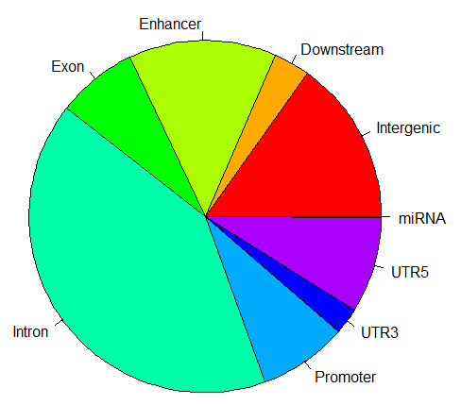
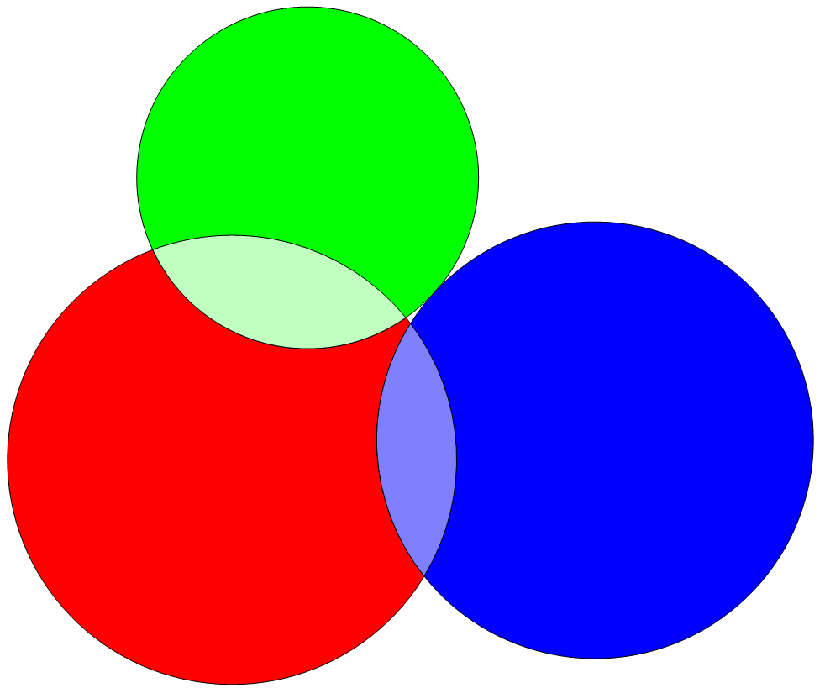
Distribution of Methylation block in human genomics
CpG island
CpG Shore
Methylation block
49,542 methylation blocks
(inferred from WGBS data of normal tissues)
Methylation blocks widely disperse in human genome, especially in gene regulation and body region.
Methylation blocks prefer non-repeat regions in human genome (mapping and functional reason)
Methylation blocks cover 0.4% repeat regions while RefGene cover 7.0% repeat region.

Slide 4
Methylation block: an independent function element
 | Observation | Expectation | Ratio | Fold change | P-value*
Virable methylation region (VMR) | 48 | 2 | 0.001 | 21.40 | < 1e-04
CpG island (CpGI) | 5845 | 379 | 0.118 | 15.43 | < 1e-04
Differentail Methylation Regions (DMR) | 2216 | 160 | 0.045 | 13.89 | < 1e-04
CpG shore (CpGsr) | 4269 | 1600 | 0.086 | 2.67 | < 1e-04
Hi-C common boundary (IMR90 and hESC) | 6322 | 4356 | 0.128 | 1.45 | < 1e-04
Hi-C topological.domain(IMR90) | 44794 | 41037 | 0.904 | 1.09 | < 1e-04
Hi-C topological.domain(hESC) | 44806 | 41808 | 0.904 | 1.07 | < 1e-04
Large organized chromatin K9 (LOCK) | 131 | 217 | 0.003 | 0.60 | < 1e-04
Lamina-associated domains (LAD) | 10639 | 18330 | 0.215 | 0.58 | < 1e-04
*Sampling 10,000 times and empirical P-value to show the significance.
Result:
Methylation block is significantly enriched in CpGI, Shore, VMR and DMR regions, while it is negatively correlated with LOCK and LAD regions. Widely correlation with all kinds of important biological function domains indicate the methylation block might play some roles in different functions.
Conclusion：
Methylation block might be an independent functional domain

Slide 5
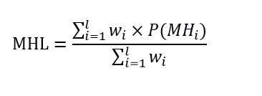
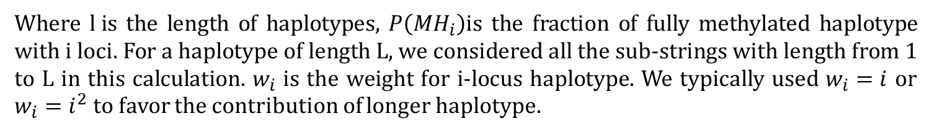
Quantitative measurement of DNA
1, Average methylation: Non-weighted average methylation values within a genomic region
2, Methylation entropy: measure the complexity of the DNA methylation within a genomic region
None any metric: Methylation Level and complexity
Give different weight to the CpG in each haplotype
Where $l i$s the length of haplotypes, $P\left({MH}_{i}\right)$is the fraction of fully methylated haplotype with i loci. For a haplotype of length L, we considered all the sub-strings with length from 1 to L in this calculation. $w_{i}$ is the weight for i-locus haplotype. We typically used $w_{i}=i$ or $w_{i}=i^{2}$ to favor the contribution of longer haplotype.

Slide 6
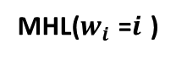
MHL : New proposed quantitation of DNA methylation
R²=1 R²=1 R²=1 R²=0 R²=-1
Methylation level
0% 100% 50% 50% 50%
Methylation entropy
0 0 0.25 1 0.25
1 1 2 16 2
0 1 0.5 0.1625 0.12
Haplotypes
MHL($w_{i}$ =$i$ )
Theoretically, MHL can detect each situation accurately
Long continuous methylated DNA fragment (LCMDF)

Slide 7
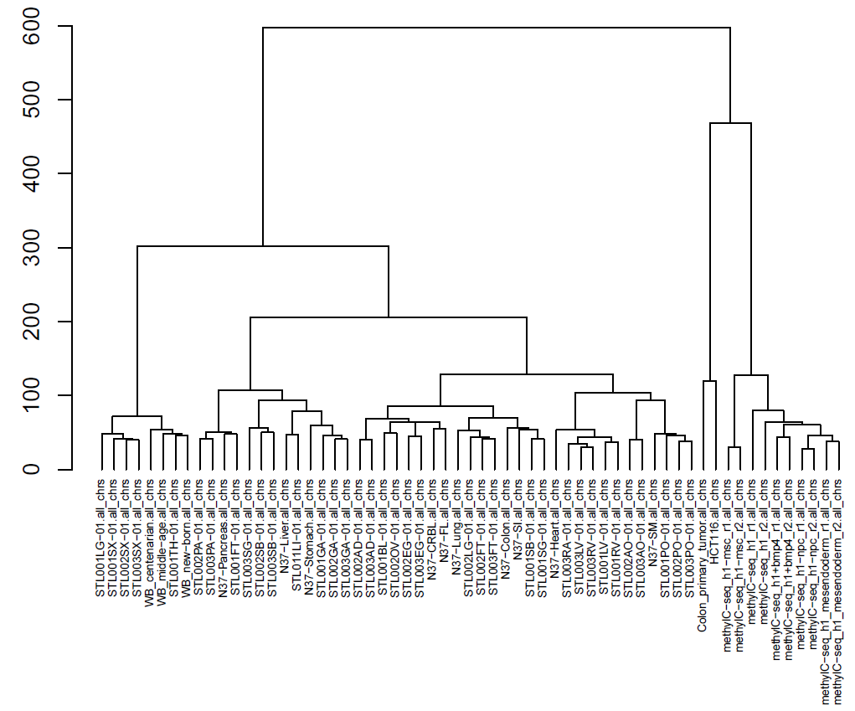
Unsupervised Cluster Analysis to 61 samples based on average methylation level
54209 MHL Regions
Average methylation level
Ambiguous cluster in the model of raw average methylation level
Conclusion: MHL have equivalent power to represent the tissues specificity compared with raw methylation in the solid tissue dataset

Slide 8
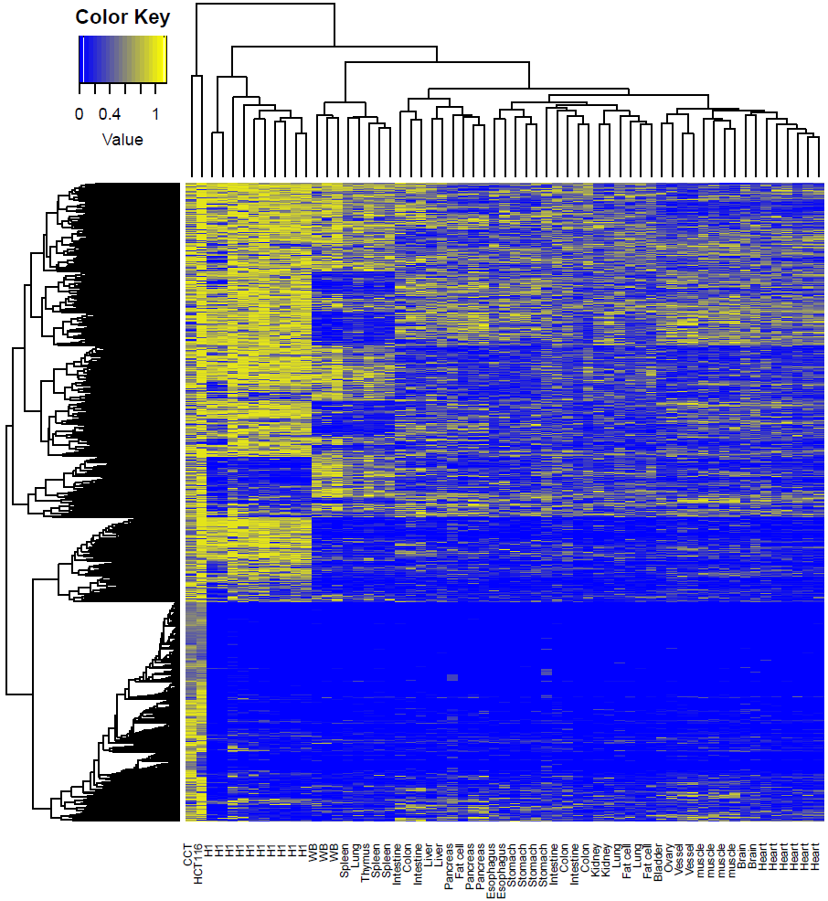
Figure 2. Heatmap analysis of the relationship among the samples

Slide 9
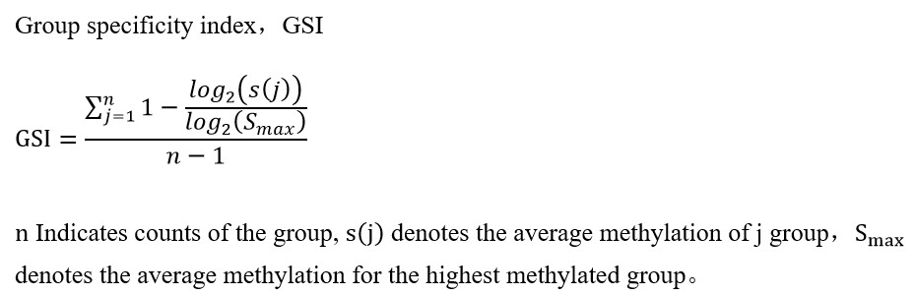
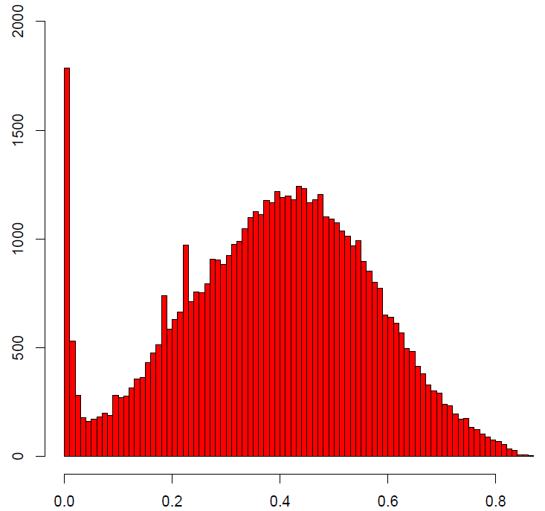
Identification of Tissue specific hyper-methylation haplotype regions
43 samples derived from 17 human normal tissues
ID | Tissue | Sample Size
1 | Bladder | 1
2 | Brain | 2
3 | Colon | 3
4 | Esophagus | 2
6 | Gastric | 2
7 | Heart | 6
8 | Intestine | 4
9 | Kidney | 2
10 | Liver | 2
11 | Lung | 3
12 | muscle | 4
13 | Ovary | 1
14 | Pancreas | 3
15 | Spleen | 3
16 | Stomach | 2
17 | Thymus | 1
18 | Vessel | 2
Tissue | Sample Size | No | Layer
Bladder | 1 | 292 | Endoterm
Brain | 2 | 34 | Ectoderm
Colon | 3 | 78 | Endoterm
Esophagus | 2 | 79 | Endoderm
Fat cell | 2 | 15 | Endoterm
Heart | 6 | 19 | Mesoderm
Intestine | 4 | 92 | Endoterm
Kidney | 2 | 186 | Mesoderm
Liver | 2 | 306 | Endoterm
Lung | 3 | 26 | Endoterm
muscle | 4 | 160 | Mesoderm
Ovary | 1 | 584 | Mesoderm
Pancreas | 3 | 559 | Endoterm
Spleen | 3 | 487 | Mesoderm
Stomach | 4 | 52 | Endoterm
Thymus | 1 | 2671 | Endoterm
Vessel | 2 | 626 | Mesoderm
0.6
6266
Sample size/Coverage
Result: large number of tissue specific hyper MHL regions were identified. These regions can be considered as basis for the deconvolution (tissue tracking)

Slide 10
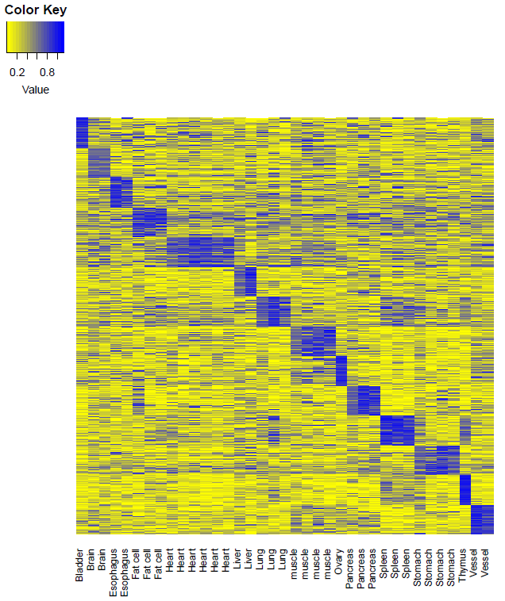
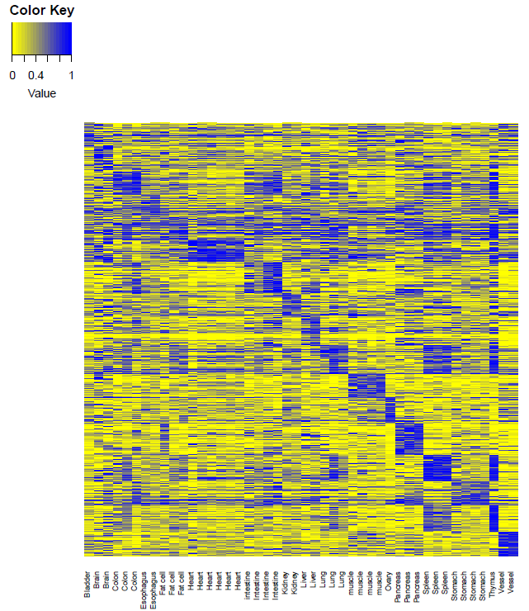
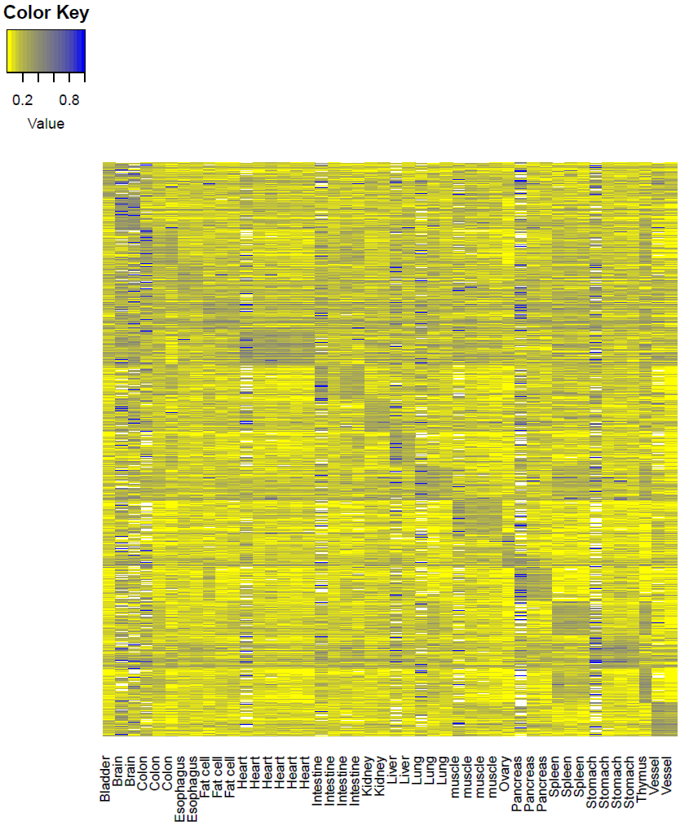
Tissue specific hyper-methylation haplotype regions to predict cancer origin
MFs
MHL
AMS
AMF
1360
7539
7647
Data extracting
Tissue specific value: 0.89 (95%CI: 0.84-0.93)
Background value: 0.29 (95%CI: 0.23-0.35)
Contrast: 0.60
Tissue specific value: 0.91(95%CI: 0.85-0.97)
Background value: 0.40 (95%CI: 0.32-0.48)
Contrast: 0.51
Tissue specific value: 0.64 (95%CI：0.55-0.73)
Background value: 0.32(95%CI: 0.29-0.35)
Contrast: 0.32
Conclusion: MHL was a stronger characteristic which can be applied for plasma DNA tissue mapping

Slide 11
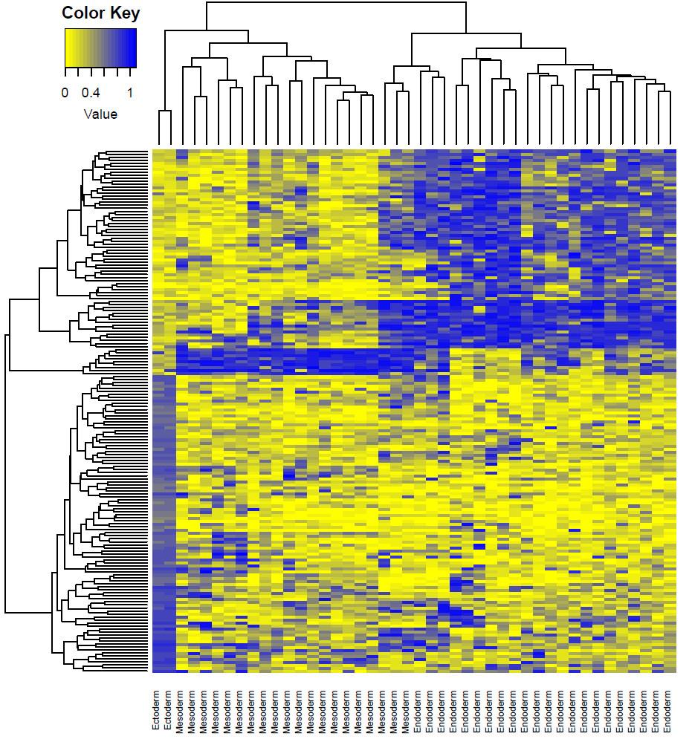
Methylation haplotype load distinguish the layer of the development
The development layers would be separated by layer specific methylation haplotype regions
Especially, ectoderm have completely different MHL regions compared with endoderm

Slide 12
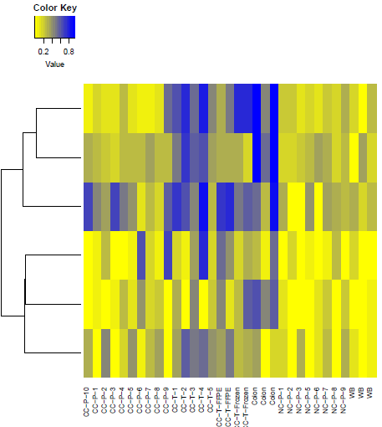
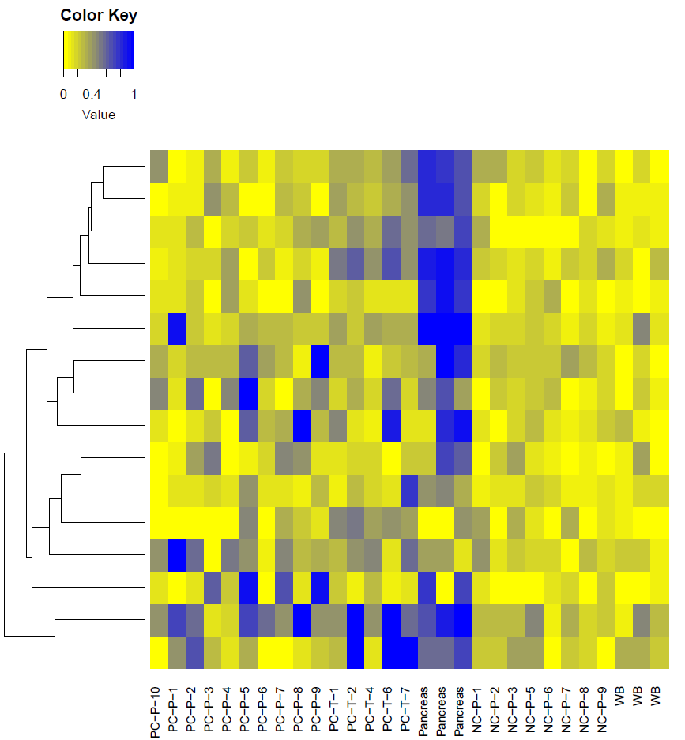
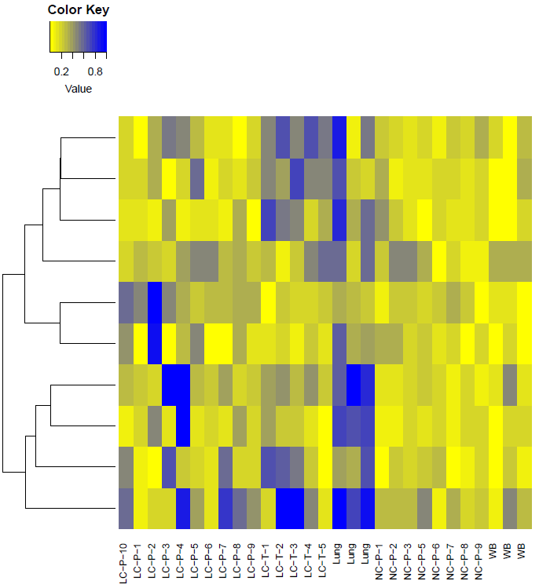
Tissue specific signatures in the plasma (Deconvolution)
Colon
Pancreas
Lung

Slide 13
Tissue specific hyper-methylation haplotype regions to predict cancer origin
RRBS dataset: 49 regions overlapped with high GSI regions
 | Colon | Lung | Pancrease | Normal Plasma
Colon | 7 | 1 | 2 | -
Lung | 1 | 8 | 1 | -
Pancrease | 2 | 1 | 7 | -
Normal Plasma | 1 | 0 | 0 | 8
Sen: 70.0%
Sen: 80.0%
Sen: 70.0%
Random Forest： 500 tree, 447 predictors, diagonal
Result: methylation haplotype load could be used for the mapping of the plasma DNA

Slide 15
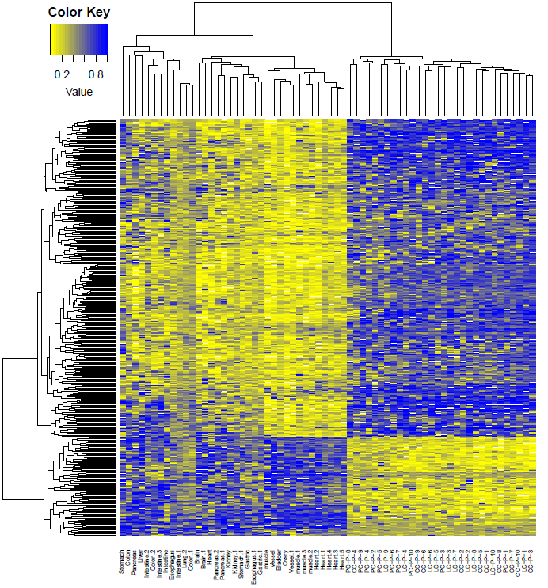
Uniform tumor signatures identified by methylation haplotype
GWBS: 82347
RRBS: 74266
Dataset: 74254*70 samples
Missing value filtering
Dataset: 2682*66 samples
35 normal tissue
66 sample
429 Signatures
327 Cancer plasma hyper-methylated
102 Cancer plasma hypo-methylated
31 tumor plasma
Result: Abundant cancer plasma signatures were identified by MHL

Slide 16
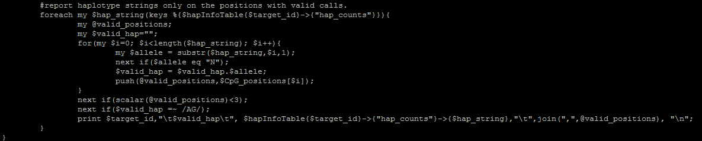
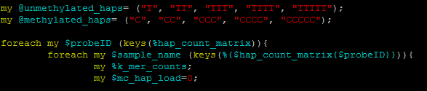
1, in the line 169 of /home/k4zhang/bin/mergedBam2hapInfo_WGBS_25Jun15.pl
in TSCC
the methylation haplotype were not output. therefore, even we remove the mentioned constraint, the methylation haplotype would be longer than 3.
2, In the line 26 and 27 of /home/k4zhang/bin/mergedBam2hapInfo_WGBS_25Jun15.pl
my @unmethylated_haps= ("T", "TT", "TTT", "TTTT", "TTTTT");
my @methylated_haps= ("C", "CC", "CCC", "CCCC", "CCCCC");
my @unmethylated_haps= ("T", "TT", "TTT", "TTTT", "TTTTT","TTTTTT","TTTTTTT");
my @methylated_haps= ("C", "CC", "CCC", "CCCC", "CCCCC","CCCCCC","CCCCCCC");
it means the haplotype whose length is longer than 5 would be ignore.
Therefore, actually, we only consider the haplotype whose length is 4 and 5.
1

Slide 17
Haplotype length >4
Whole MB: 90%
Haplotype length > =3
Whole MB: 63.81%
25584: miss value < 15.7%
Notes:
The number of the haplotype whose length is 3 is greatly more than haplotypes which length is 3, 4, 5 even more.

Slide 18
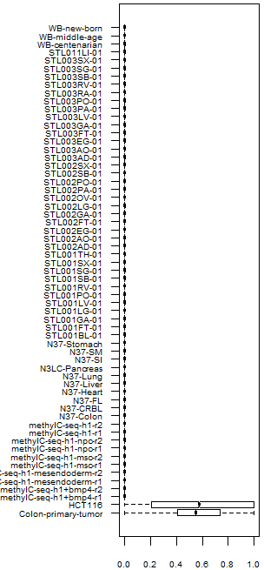
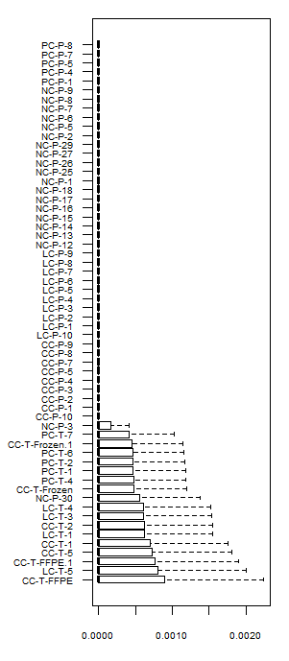
Significant Increasing of the methylation haplotype load in cancer tissues
WGBS
RRBS
Plasma
Methylation haplotype load showed significant large number of hyper-methylation regions in cancer tissues both in GWBS and RRBS dataset.
Cancer
Solid
Normal
Extract the regions of GWBS overlapped with RRBS and the distribution do not have dramatically change.
Methylation haplotype load
Methylation haplotype load

Slide 19
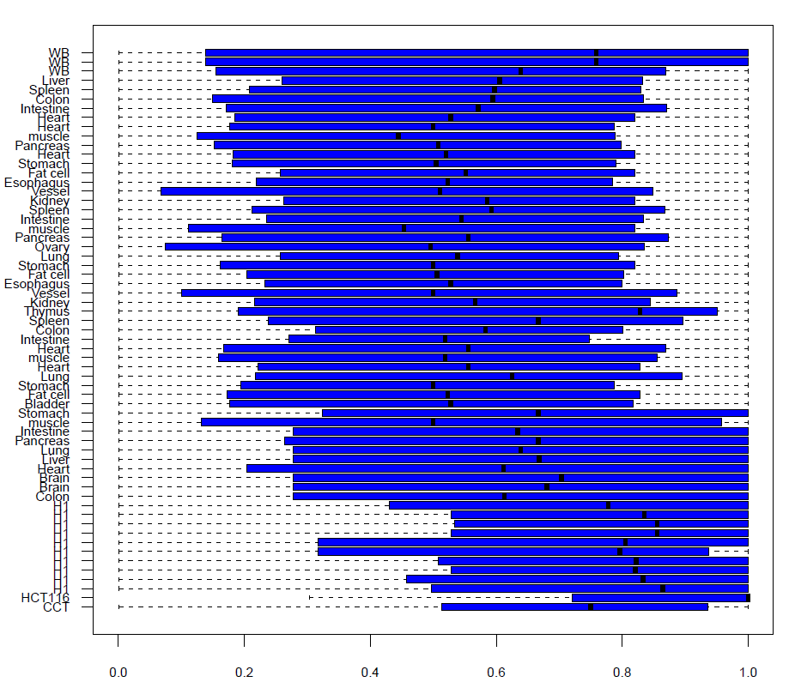

Slide 20
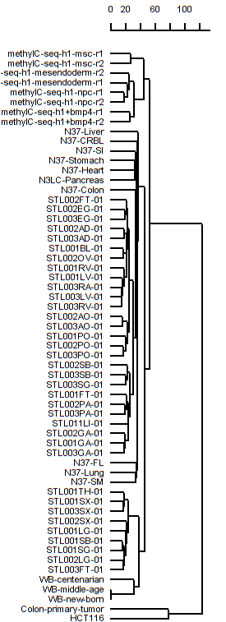
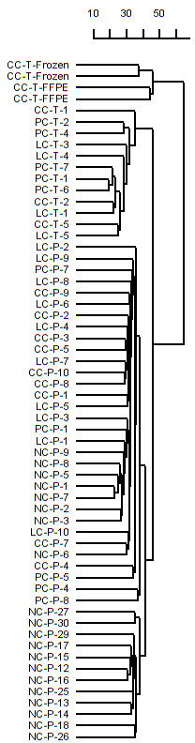
Methylation haplotype load in differential samples: Somatic, Stem, Plasma
Stem cell
Cancer tissue
Somatic cell
Cancer cell
Cancer plasma
Cluster analysis showed genome-wide MHL based on GWBS dataset could distinguish the samples with very high accuracy.
Cluster analysis were conducted with Euclidean distance and ward agglomeration.

Slide 21
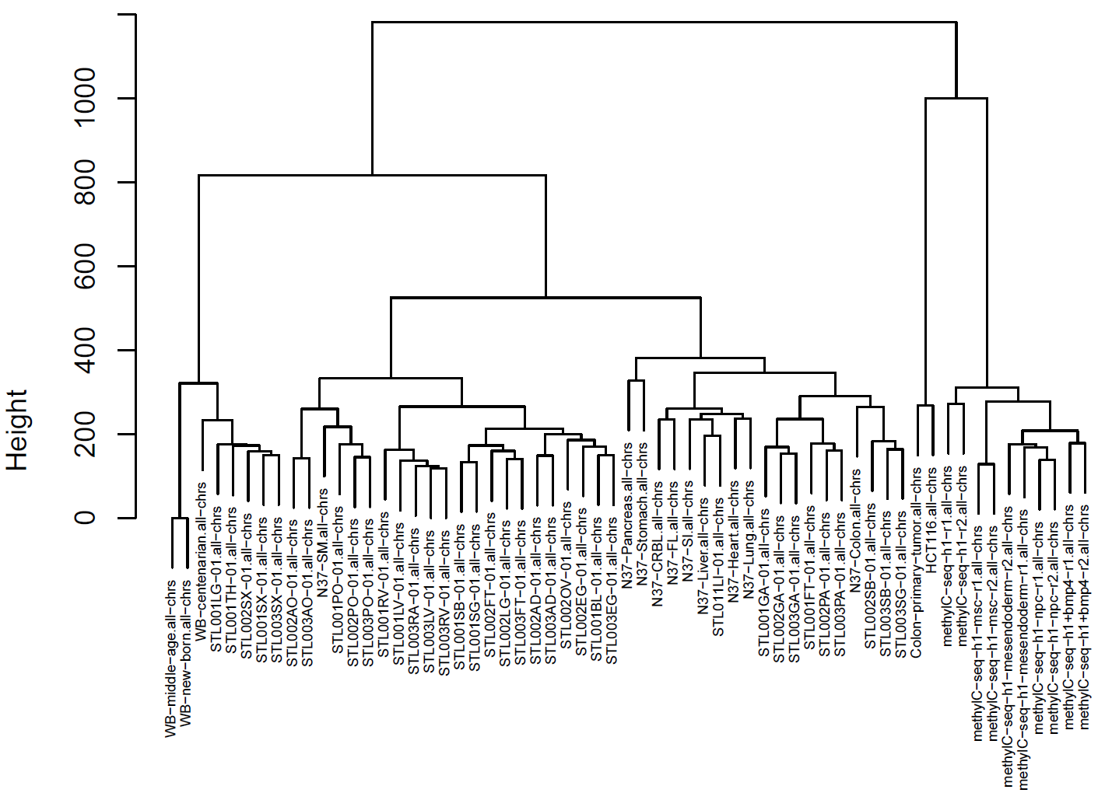
Liver and colon from N37 and SALK cluster together

Slide 22
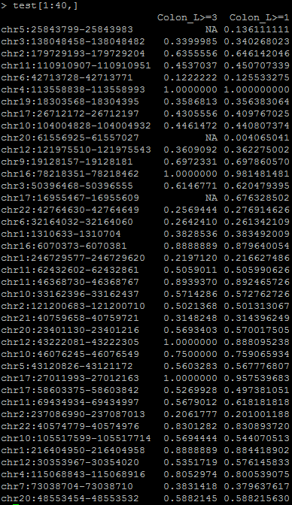
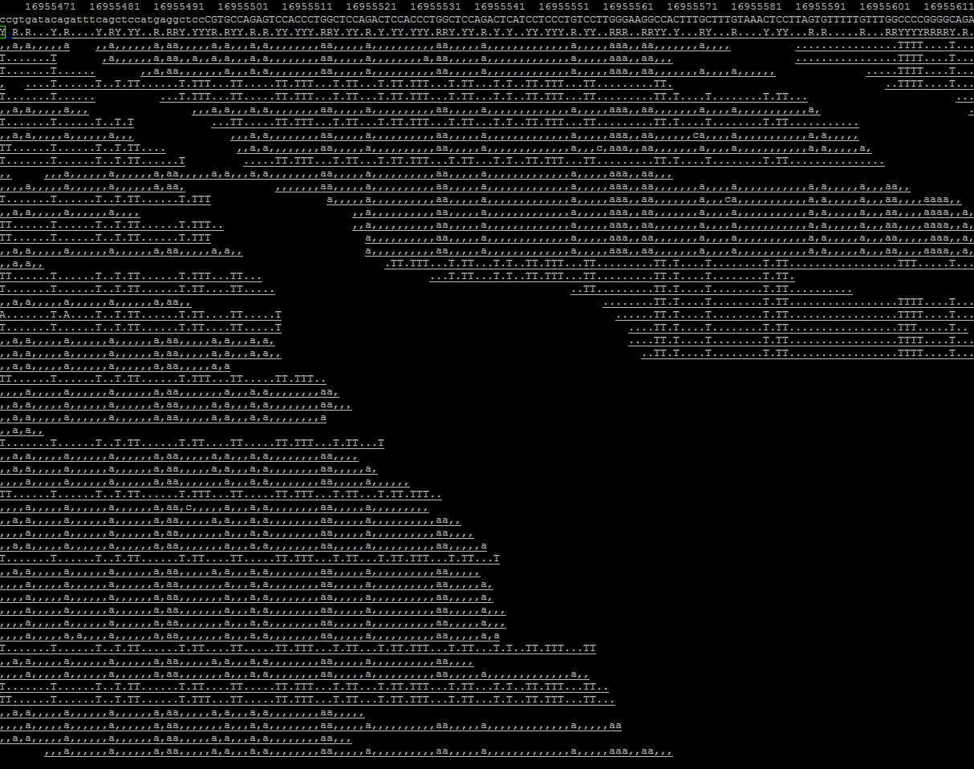
Comparison between the MHL built with constraint L>=3 and L>=1
chr17:16955467-16955609 in Colon_primary_tumor.chr17.sorted.clipped.bam
142bp
Example of the miss value
Regions whose methylation density is low will be NA in matrix
Notes:
I don’t set constrain for the length of the haplotype.

Slide 23
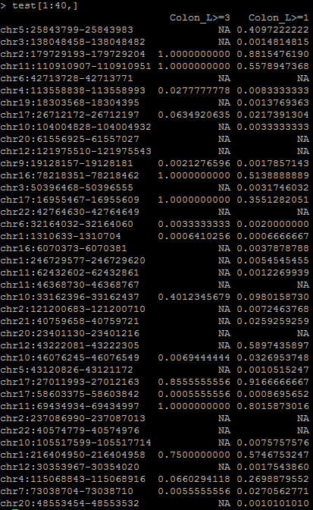
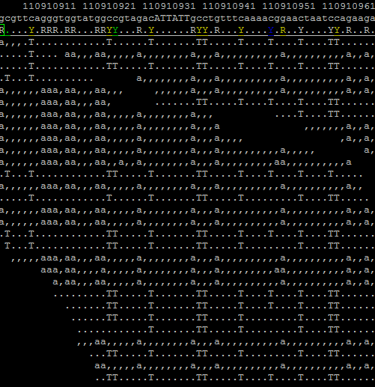
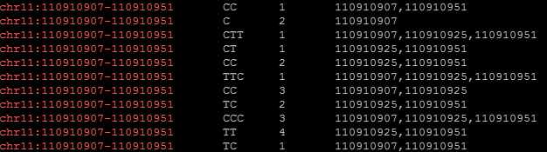
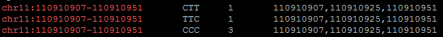
# chr11:110910907-110910951 in middle-age.chr11.rmdup.bam
HML=0.37
HML=0.55
Notes:
I calculated the methylation haplotype load manually

Slide 24
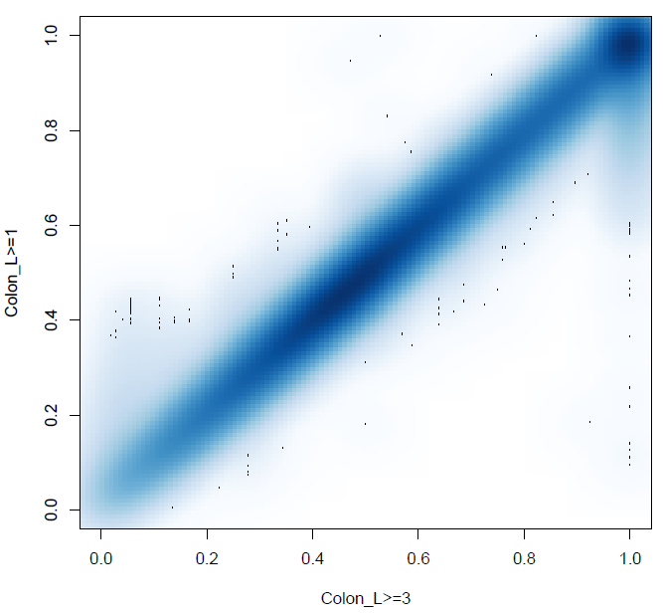
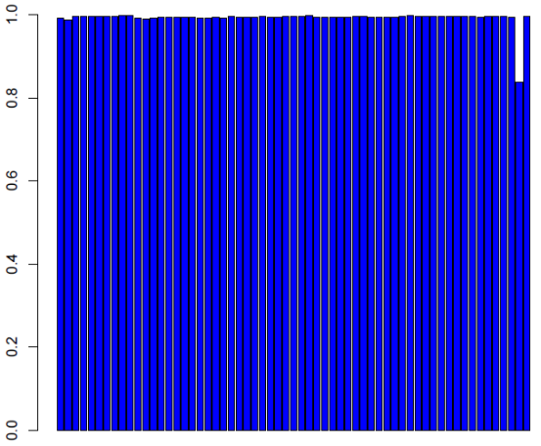
Correlation between the MHL built with constraint L>=3 and L>=1
WB_middle-age
1, Correlation of the non-missing value of MHL in the model of L>=3 or L>=1 were very high.
2, L>=1 can increase the valid feature dramatically.
2682 non-missing value MHL Regions
54209 non-missing value MHL Regions

Slide 25
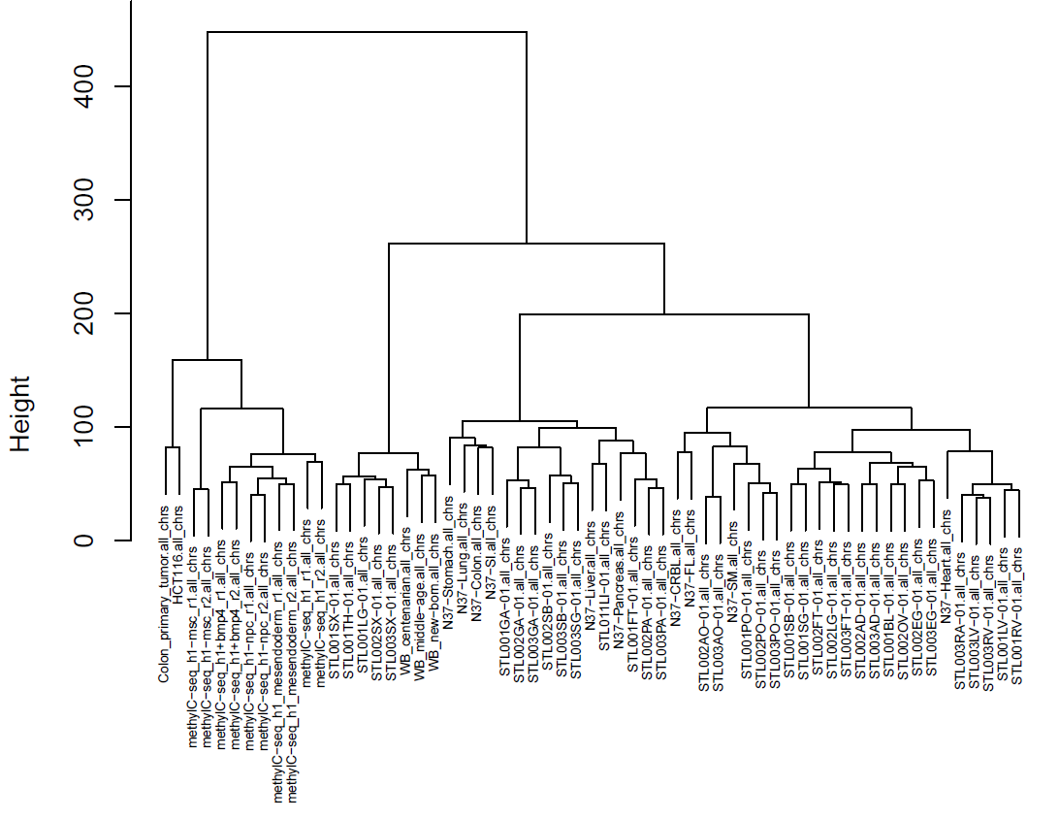
Unsupervised Cluster Analysis to 61 samples based on Genome-wide MHL
Raw MHL
Imputation
Quantile normalization
Batch effect adjustment
54209 MHL Regions
Unsupervised Cluster Analysis
Maybe caused by demographic characteristics of the sample
Notes:
Assemble together

Slide 26
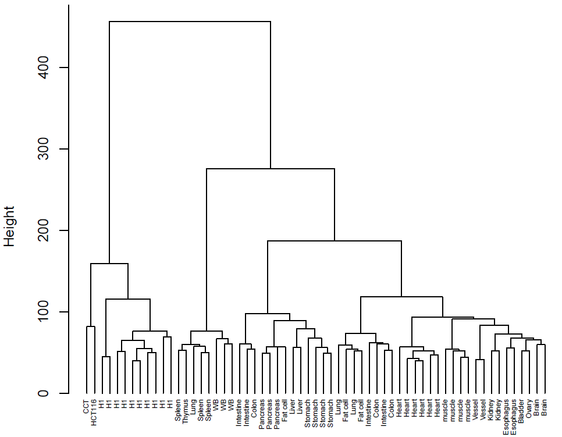
Unsupervised Cluster Analysis to 61 samples based on Genome-wide MHL value
54209 MHL Regions
Aggregation of the samples from same study were disappeared
Same kinds of tissue cluster together

Slide 27
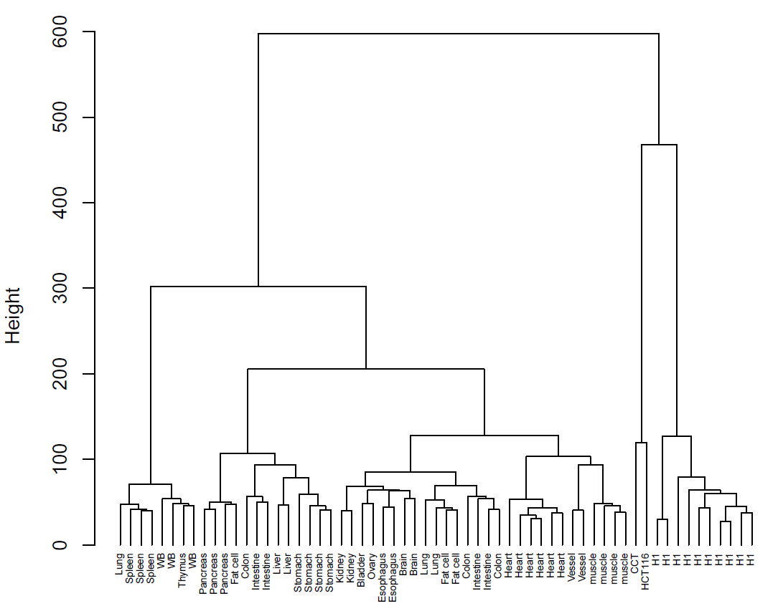
Unsupervised Cluster Analysis to 61 samples based on average methylation level of MHL regions
54209 MHL Regions
Average methylation level

Slide 28
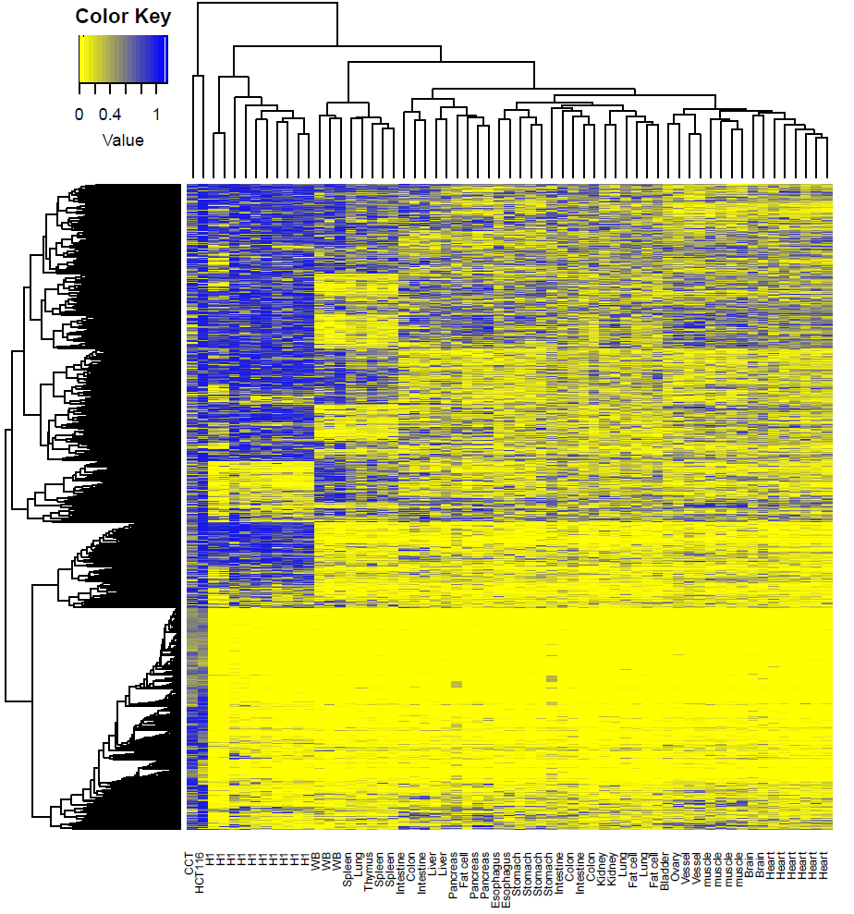
Unsupervised Cluster Analysis to 61 samples based on Genome-wide MHL
Yellow to blue
Blue to Yellow

Slide 29
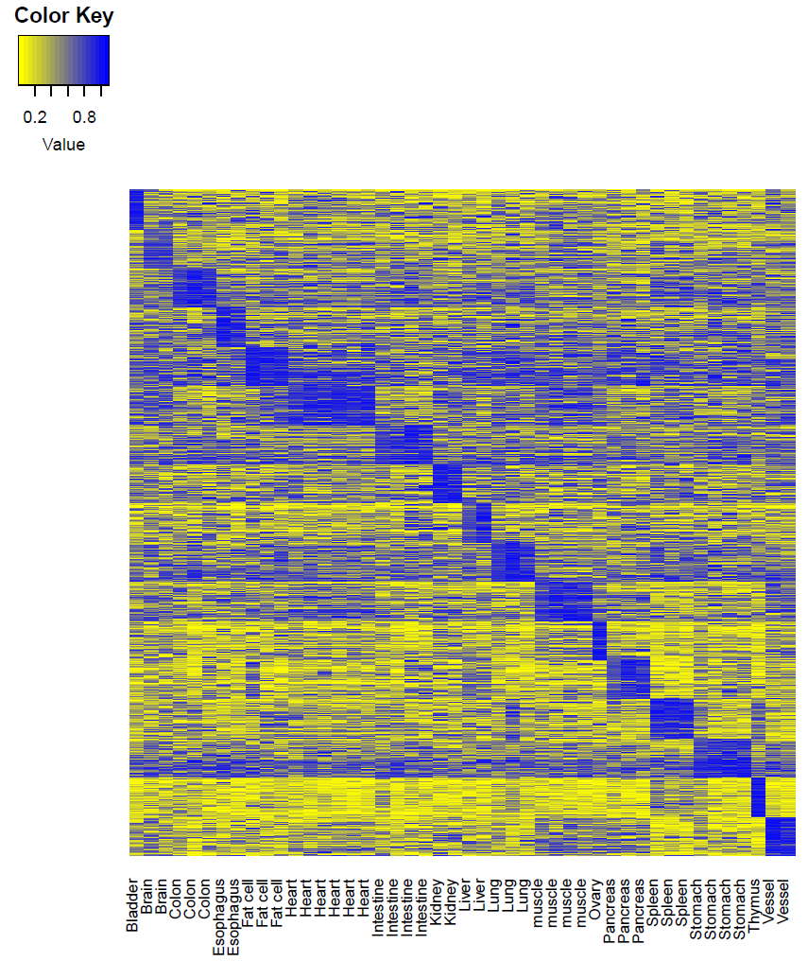
Identification of Tissue specific hyper-methylation haplotype regions
1360 Tissue specific hyper-methylation haplotype regions
17 solid tissues
Yellow to blue

Slide 31
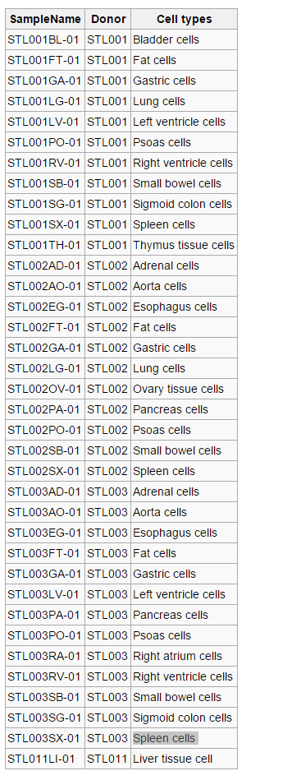

Slide 32
Cluster analysis based on traditional average methylation level

Slide 33
1, in the line 169 of /home/k4zhang/bin/mergedBam2hapInfo_WGBS_25Jun15.pl
in TSCC
the methylation haplotype were not output. therefore, even we remove the mentioned constraint, the methylation haplotype would be longer than 3.
2, In the line 26 and 27 of /home/k4zhang/bin/mergedBam2hapInfo_WGBS_25Jun15.pl
my @unmethylated_haps= ("T", "TT", "TTT", "TTTT", "TTTTT");
my @methylated_haps= ("C", "CC", "CCC", "CCCC", "CCCCC");
my @unmethylated_haps= ("T", "TT", "TTT", "TTTT", "TTTTT","TTTTTT","TTTTTTT");
my @methylated_haps= ("C", "CC", "CCC", "CCCC", "CCCCC","CCCCCC","CCCCCCC");
it means the haplotype whose length is longer than 5 would be ignore.
Therefore, actually, we only consider the haplotype whose length is 4 and 5.
1

Slide 34
Haplotype length >=1
Whole MB: 43.65%
54209 features: miss value < 2.7%

Slide 35
This week!
1, check the code from bam2haplotype and haplot2hml
1, GWBS (WB) Vs RRBS tumor solid tissue
2, RRBS normal plasma vs RRBS cancer plasma
3, compared with PNAS dataset
4, thinking why methylation block is important in human genome

Slide 36
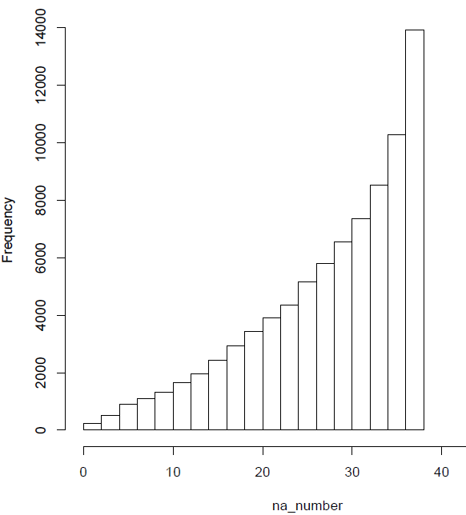
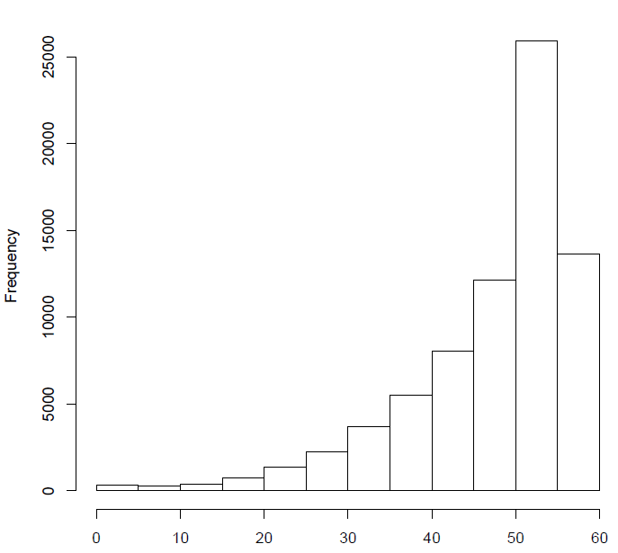
Missing Value in GWBS(left) and RRBS(right)
38 samples
56 samples
Methylation block: 49,542
PNAS regions: 5,820
1,622 regions
WGSB regions: 82,348
PNAS regions: 5,820
? regions
RRBS regions: 74,267
PNAS regions: 5,820
? regions

Slide 37
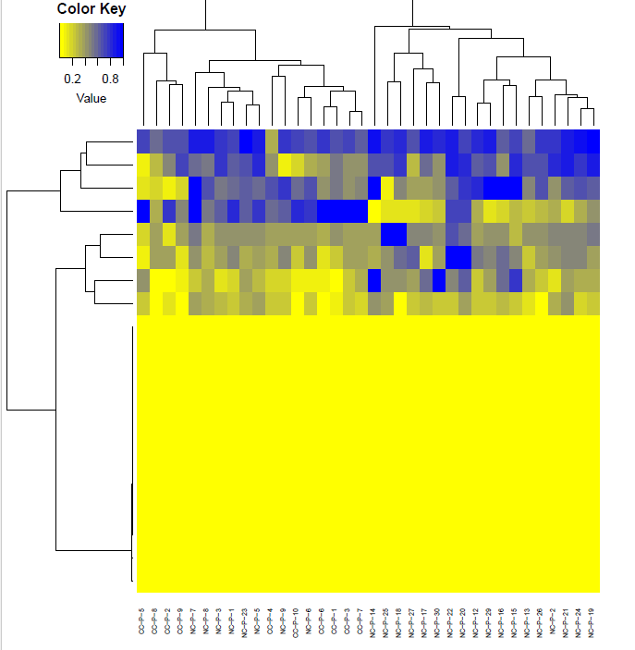

Slide 39
Messages Take Home
Methylation block is an independent genomic elements from current methylation domains, such as CpGI and CpG shore.
Methylation block is a conservative phenomena in different platform and tissues
A novel proposed metric Methylation haplotype load is a better measurement for cancer diagnosis and plasma DNA tracking
Hundreds of Cancer plasma specific signatures were identified
Sequencing Depth: The more than better. hate the missing value…

Slide 40
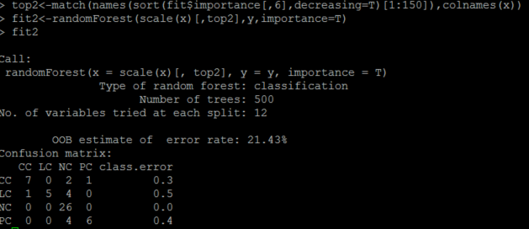
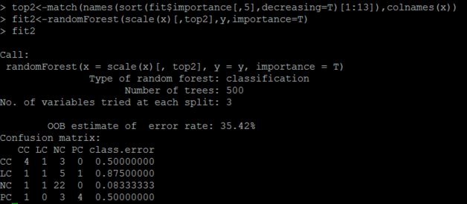
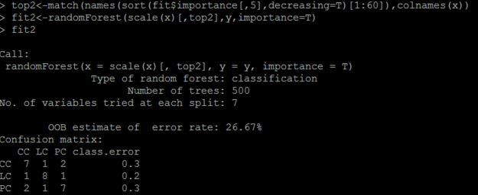
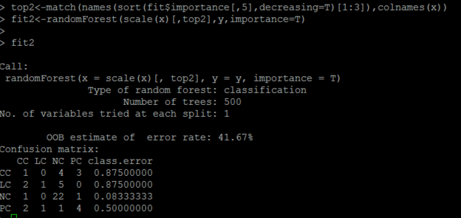
Supplementary
RRBS dataset, stage I. top 150
Seq-Cap dataset, stage I. top 150
RRBS dataset, stage II. top 150
Seq-Cap: dataset, stage II. top 150

Slide 41
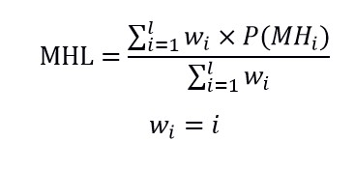
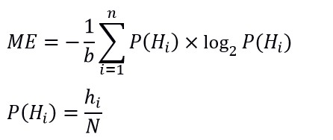
Definition of methylation haplotypes and methylation haplotype blocks
Methylation haplotype is collection of adjacent methylation status in specific genome region.
Methylation haplotype block is genomic region in which the methylation correlation between adjacent CpG loci were relatively higher compared with the expectation.
Methylation haplotype load is proposed to measure the methylation level for the methylation blocks which is weighted by the length of the haplotype.
Methylation entropy is a extent measurement to DNA methylation based on traditional Shannon entropy. It can be used to evaluate the epigenetic heterogeneity.
$w_{i}$ is to favor the contribution of longer haplotype

Slide 42
0% 100% 50% 50% 50% 50%
R²=1 R²=1 R²=1 R²=0 R²=-1 R²=1
Methylation haplotype
1 1 2 16 2 2
1 1 1 0.325 0.23 0.23
0 0 0.5 2 0.5 0
0 1 0.5 0.5 0.5 0.5
MHL($w_{i}$ =$i$ )
2 × Methylation entropy
Methylation level

Slide 43
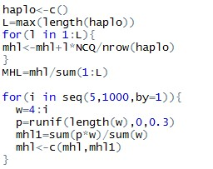
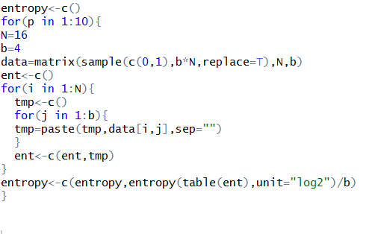
Methylation haplotype load implement in R and Perl
Methylation entropy implement in R and Perl

Slide 44

Distribution of Methylation block in human genomics
0.4%
7.0%
49,542 methylation blocks
(inferred from WGBS data of normal tissues)
Methylation blocks widely disperse in human genome, especially in gene regulation and body region.
Methylation blocks prefer non-repeat regions in human genome (mapping and functional reason)
Methylation blocks cover 0.4% repeat regions while RefGene cover 7.0% repeat region.

Slide 45
Methylation block inferred from microarray and RRBS dataset
Block: >=4 CpG loci and average correlation of the adjacent CpG among the region > 0.6
Methylation 450K Array
Encode
Symbol | Case | Control | Tissue types (Cancer types)
KIRC | 160 | 160 | Kidney
BRCA | 92 | 92 | Breast
THCA | 56 | 56 | Thyroid
HNSC | 50 | 50 | Head and Neck
PRAD | 49 | 49 | Prostate
LIHC | 49 | 49 | Liver
KIRP | 45 | 45 | Kidney
LUSC | 41 | 41 | Lung squamous cell
COAD | 39 | 39 | Colon
UCEC | 30 | 30 | Uterine Corpus Endometrial
LUAD | 26 | 26 | Lung
101 RRBS (bed files) were downloaded. 2,646,999 CpG loci were covered by 101 RRBS data while 866,979 CpG loci (32.8%) were detected in at least 80% samples.
How many kinds of cell?
mesoderm
ectoderm
Inner cell mass
Decidua
Epithelium
Blood
neurons
155 blocks
1885 blocks

Slide 46




Array: Fold change: 23.4, P-value<1.0 × 10⁻¹⁶
RRBS: Fold change: 19.8, P-value<1.0 × 10⁻¹⁶
Array RRBS
P-value<2.2 × 10⁻¹⁶
P-value<2.2 × 10⁻¹⁶
Methylation block regions were significantly conserved in different dataset or platform
Shared methylation block have significant higher correlation compared with regions beyond methylation block.

Slide 47

Methylation block conservation among 11 human normal tissues
2421 methylation block regions (59.97% in WGBS) were collected from 11 tissues. The probability of the number occurred in different tissues would be in a exponential decay as the red lines showed (P=0.4). However, we found a regions significantly deviate from the theoretical distribution (P<2.2 × 10⁻¹⁶,chi-square test) and therefore, the methylation block have strong conservation in different tissues.
Exponential decay
Conservation
P=length(blocks)/(length(uniqueblock)*event.time)
Notes:
Methylation block in human genome’s observation.

Slide 49


Methylation block conservation between different tissues: PBMC and solid tissues
TCGA
P<1.92× 10⁻⁹
32.9%-41.9%
GSE35069:Differential DNA Methylation in Purified Human Blood Cells (CD4+,CD8+,CD19+)
GSE41169:Blood DNA methylation profiles in a Dutch population (62 schizophrenia and 33 normal )
GSE42861:Differential DNA methylation in the PBMC from 354 Rheumatoid arthritis and 337 normal
Methylation blocks were conservative between PBMC and solid tissues. 32.9-41.9% regions were shared between PBMC and solid tissues. P<1.92× 10⁻⁹
Notes:
Remove the effect of the CpG Island
Gatk indel is better and samtools.

Slide 50

TCGA
68 51 104
32.9%-41.9%
34 33 51
2421 blocks
CpG Island
984 blocks
39.29%-49.29%
34 18 53
18
Non-CpG Island
O[984(52),2421(71)]
25.35%-34.61%
10,000 iterations, P<10⁻⁴

Slide 51
Methylation block difference between cancer and normal
Correlation between the high CpG region were significantly higher in cancer compared with normal tissues, especially
Here choose colon, lung and pancreatic cancer (no data)

Slide 52




Methylation haplotype emergence in cancer genomes
Colon cancer Colon normal
PADI2
Notes:
chr1:2345333-2345410
load(file[j])
cancer<-substr(file[j],1,4)
data<-RawNARemove(data)
data<-impute.knn(data)$data
map<-map[map[,4] %in% rownames(data),]
newdata<-data[match(map[,4],rownames(data)),]
cor1<-mean(cor(t(newdata[rlt[j,1]:rlt[j,2],seq(1,ncol(newdata),by=2)]),use="complete.obs")) # cancer
cor2<-mean(cor(t(newdata[rlt[j,1]:rlt[j,2],seq(2,ncol(newdata),by=2)]),use="complete.obs")) # normal
tmp<-c(cor1,cor2)
cor<-rbind(cor,tmp)
load("COAD.mh.cor.RData")
load("COAD.mh.rlt.RData")
j<-match("chr1:17445929-17446087",rownames(rlt))
cor1<-cor(t(newdata[rlt[j,1]:rlt[j,2],seq(1,ncol(newdata),by=2)]),use="complete.obs") # cancer
cor2<-cor(t(newdata[rlt[j,1]:rlt[j,2],seq(2,ncol(newdata),by=2)]),use="complete.obs") # normal
M1<-rltt$cor1
M2<-rltt$cor2
M1[lower.tri(M1)] <- NA
M2[lower.tri(M2)] <- NA
col=colorRampPalette(c("white", "red"))(20)
pdf("figure.pdf")
image(M1,col =col,frame=F,xaxt="n",yaxt="n")
image(M2,col =col,frame=F,xaxt="n",yaxt="n")
dev.off()
library("grDevices")
plot(1:20,pch=20,col=col)
col=colorRampPalette(c("white", "red"))(20)
M <- matrix(runif(100),10,10)
M[lower.tri(M)] <- NA
image(M,col = col,frame=F,xaxt="n",yaxt="n")

Slide 53
Significant Increasing of the methylation haplotype load in cancer tissues
WGBS
RRBS
Plasma
Methylation haplotype load showed significant large number of hyper-methylation regions in cancer tissues both in GWBS and RRBS dataset.
Cancer
Solid
Normal
Extract the regions of GWBS overlapped with RRBS and the distribution do not have dramatically change.
Methylation haplotype load
Methylation haplotype load

Slide 54
Methylation haplotype load in differential samples: Somatic, Stem, Plasma
Stem cell
Cancer tissue
Somatic cell
Cancer cell
Cancer plasma
Cluster analysis showed genome-wide MHL based on GWBS dataset could distinguish the samples with very high accuracy.
Cluster analysis were conducted with Euclidean distance and ward agglomeration.

Slide 55
Conclusion
Methylation haplotype block has strong conservation among different tissues and platforms.
Methylation haplotype load showed significant large number of hyper-methylation regions in cancer tissues both in Microarray, GWBS and RRBS dataset.
Cluster analysis showed genome-wide MHL based on GWBS dataset could distinguish the samples with very high accuracy.
Methylation haplotype based DNA methylation analysis would be useful method to discover the difference between disease status or development process.

Slide 56
Influence of biological variations to methylation haplotype load
For this analysis, 15 pairs of solid tissue and matching plasma samples were collected. The regions with higher MHL in solid tissues than plasma were defined as tissue-dominant MHL (T-MHL), and regions with higher MHL in plasma than in solid tissues were defined as plasma-dominant MHL (P-MHL). We assume that cell-free DNA typically come from apoptotic cells, and are in small fragments (Chan et al. 2004), while whole blood DNA typically have larger sizes (at least kilobases) even after DNA extraction. Therefore, we hypothesize that P-MHL is longer than T-MHL. The results showed that the length of P-MHL are significantly longer than T-MHL in all the sample sets.
MHL in Plasma
T-MHL: MHLs which Tissue >= Plasma
P-MHL: MHLs which Plasma > Tissue
Difference of the length MHL between T-MHL and P-MHL??

Slide 57
Significant difference of the length MHL between T-MHL and P-MHL
 | T-MHL(bp) | P-MHL(bp) | Fold-Change | Delta(bp) | P-value
6-P-1 | 138 | 164 | 1.19 | 26 | 1.43E-25
6-P-2 | 149 | 154 | 1.03 | 5 | 4.34E-02
6-P-3 | 146 | 159 | 1.09 | 13 | 1.69E-09
6-P-4 | 136 | 157 | 1.15 | 21 | 3.10E-19
6-P-5 | 135 | 166 | 1.23 | 31 | 6.94E-32
7-P-1 | 138 | 159 | 1.15 | 21 | 3.36E-23
7-P-2 | 137 | 169 | 1.23 | 32 | 5.64E-32
7-P-3 | 137 | 167 | 1.22 | 30 | 1.74E-31
7-P-4 | 139 | 158 | 1.14 | 19 | 1.63E-18
7-P-5 | 132 | 177 | 1.34 | 45 | 5.71E-66
PC-P-1 | 131 | 171 | 1.31 | 40 | 1.86E-45
PC-P-2 | 133 | 161 | 1.21 | 28 | 6.73E-37
PC-P-4 | 127 | 167 | 1.31 | 40 | 1.61E-62
PC-P-6 | 132 | 176 | 1.33 | 44 | 3.05E-66
PC-P-7 | 128 | 171 | 1.34 | 43 | 3.75E-63
Length of P-MHL are significantly longer than T-MHL in all the sample sets.
Notes:
For this analysis, 15 pairs of solid tissue and matching plasma samples were collected. The regions with higher MHL in solid tissues than plasma were defined as tissue-dominant MHL (T-MHL), and regions with higher MHL in plasma than in solid tissues were defined as plasma-dominant MHL (P-MHL). We assume that cell-free DNA typically come from apoptotic cells, and are in small fragments (Chan et al. 2004), while whole blood DNA typically have larger sizes (at least kilobases) even after DNA extraction. Therefore, we hypothesize that P-MHL is longer than T-MHL. The results showed that the length of P-MHL are significantly longer than T-MHL in all the sample sets.

Slide 58

Methylated Haplotype Loading (MHL) for a genome region
Where $l i$s the length of haplotypes, $P\left({MH}_{i}\right)$is the fraction of fully methylated haplotype with i loci. For a haplotype of length L, we considered all the sub-strings with length from 1 to L in this calculation. $w_{i}$ is the weight for i-locus haplotype. We typically used $w_{i}=i$ or $w_{i}=i^{2}$ to favor the contribution of longer haplotype.
1, MHL is the unbiased estimate of methylation for a genome region
2, MHL ranges from 0 to1
Shoemaker R, Deng J, Wang W, Zhang K. Genome research. 2010;20(7):883-9
Notes:
MHL is the unbiased estimate of methylation for a genome region and MHL ranges from 0 to1

Slide 59

RRBS covered genomic regions

Slide 60
Description of methylation haplotypes and methylation haplotype blocks.
Systematic search of methylation haplotype blocks in the human genome.
Distribution of haplotype diversity across tissues and different methylation haplotype blocks.
Definition of methylated haplotype loads and estimation of tumor fraction using MHL.
Detection of tumor methylated haplotypes in plasma.

Slide 61

Relationship between Methylation haplotype block and important methylation features
88.8%
48%
27%
7.6% 5.4%
LAD: lamina-associated domains, gene silence, require the involvement of methylation blocks
LOCKS: phenotypic plasticity, partially (48%) require methylation blocks
DMV: DNA methylation valley, conserved, partially (27%) require methylation blocks
LMR: low methylation region, dynamic, do not require methylation blocks
UMR: low methylation region, dynamic, do not require methylation blocks
Methylation memory region (MMR): on the way…
Variably methylation region (VMR): implemented in CHARM, no genome-wide searching method
Hi-C : (Nature 485, 376–380): on the way…
Notes:
VMR: Nature 485, 376–380

Slide 62

Methylation haplotype block regions enriched in Annotation regions
Ref | Observation | Expectation | Ratio | Fold Change | pvalue
VMR | 48 | 3 | 0.000969 | 20.4 | < 0.005
CpG Island | 5,845 | 379 | 0.117981 | 15.4 | < 0.005
CpG Shore | 4,269 | 1596 | 0.086169 | 2.6 | < 0.005
Hi-C Common Boundary | 6,322 | 4,357 | 0.127609 | 1.4 | < 0.005
Hi-C Topological Ddomain (IMR90) | 44,794 | 4,1041 | 0.904162 | 1.1 | < 0.005
Hi-C Topological Domain (hESC) | 44,806 | 4,1802 | 0.904404 | 1.1 | < 0.005
LOCK | 131 | 215 | 0.002644 | 0.6 | < 0.005
LAD | 10,639 | 18319 | 0.214747 | 0.6 | < 0.005
48
VMR

Slide 63
1, Remove H1, WBC
2, Just keep few H1, WBS specific hypermethylation regions
3, select classic specific genes for each tissue

Slide 64
Annotation enriched in Methylation haplotype block regions
ref | observation | expectation | ratio | Fold Change | P-value
VMR.charm.PMID20844285.hg19.bed | 21 | 2.03 | 0.092511013 | 10.34482759 | < 0.005
CpGI.hg19.bed | 2188 | 337.225 | 0.076260848 | 6.488249685 | < 0.005
CpG.Shore.hg19.bed | 3321 | 1324.01 | 0.070935771 | 2.508289212 | < 0.005
Hic.common.boundary.hESC.IMR90.hg19.bed | 1392 | 1108.33 | 0.804159445 | 1.255943627 | < 0.005
Hic.topological.domain.IMR90.hg19.bed | 2201 | 1937.2 | 0.961135371 | 1.136175924 | < 0.005
Hic.topological.domain.hESC.hg19.bed | 2915 | 2581.47 | 0.951992162 | 1.129201579 | < 0.005
LAD.hg19.bed | 1156 | 1046.99 | 0.887864823 | 1.104117518 | < 0.005
LOCK.hg19.bed | 32 | 32.175 | 0.484848485 | 0.994560995 | 0.425

Slide 65

Relationship between methylation haplotype block with Transcriptional binding region of 161 TF from Encode Project
1, 0.085%-9.4% TFBR contain methylation haplotype block
2, lowest: POU5F1, FAM48A, BRF2, MAFF, SETDB1
3, highest: MTA3, IKZF1, SMARCC1, SMARCB1, NFATC1
methylation sensitive ?
Enrich fold= 2-45 X
proportion
161 Transcriptional Factors
Notes:
Significance of Overlap: For the intersections of more than two groups, we performed simulations to determine the empirical P-value. For each list, we randomly selected x number of null regions from the background set (x = observed size), and we determined the overlap size expected by chance from 10⁵ repetitions. The empirical P-value is calculated as the number of times the actual observed overlap is smaller than the null overlap divided by the total number of simulations.

Slide 66
Flow diagram of options and analysis units in DMAP

Slide 67
False Positive Co-occurrences/Enrichment
1, CRG mapability : Mapability or Uniqueness of Reference Genome
22M genome postion were excluded.
DAC Blacklisted Regions: 11,588,272bp (anomalous, unstructured)
Duke Excluded Regions: 10,734,023bp (satellites and rRNA genes)
2. Haiminen N, Mannila H, Terzi E. Determining significance of pairwise co-occurrences of events in bursty sequences. BMC bioinformatics 2008;9:336.
3.Fu AQ, Adryan B. Scoring overlapping and adjacent signals from genome-wide ChIP and DamID assays. Molecular bioSystems 2009;5:1429-38.

Slide 68

Tissue Specific Hypermethylated Methylation Haplotype Block Regions
 | Tissue | Freq
1 | Bladder | 1
2 | Brain | 2
3 | Colon | 3
4 | Esophagus | 2
5 | Fat cell | 3
6 | Gastric | 2
7 | Stem Cell | 10
8 | Heart | 6
9 | Intestine | 4
10 | Kidney | 2
11 | Liver | 2
12 | Lung | 3
13 | muscle | 4
14 | Ovary | 1
15 | Pancreas | 3
16 | Spleen | 3
17 | Stomach | 2
18 | Thymus | 1
19 | Vessel | 2
20 | WB | 3
 | Tissue | Sample Size | GSI>0.7 | GSI>0.8
1 | Bladder | 1 | 137 | 61
2 | Brain | 2 | 194 | 133
3 | Colon | 3 | 26 | 1
4 | Esophagus | 2 | 25 | 6
5 | Fat cell | 3 | 4 | 0
6 | Gastric | 2 | 15 | 2
7 | H1 | 10 | 1435 | 743
8 | Heart | 6 | 3 | 0
9 | Intestine | 4 | 12 | 1
10 | Kidney | 2 | 47 | 12
11 | Liver | 2 | 170 | 57
12 | Lung | 3 | 5 | 0
13 | muscle | 4 | 38 | 9
14 | Ovary | 1 | 194 | 78
15 | Pancreas | 3 | 111 | 24
16 | Spleen | 3 | 16 | 3
17 | Stomach | 2 | 19 | 5
18 | Thymus | 1 | 775 | 230
19 | Vessel | 2 | 140 | 57
20 | WB | 3 | 2440 | 1079
82347
5806
Group Specificity Index
Notes:
82347

Slide 69

Detection power to plasma based on identified tissue signatures
WGBS
Validation dataset： RRBS (24 samples)
Criterion: >20% marker positive
1，lung cancer： 7/9=77.7%
2，colon cancer：6/10=60.0%
3，pancreatic cancer：5/5=100%
Validation dataset： BSPP (16 samples)
Criterion: >20% marker positive
1，lung cancer： 5/8=62.5%
2，colon cancer：6/8=75.0%

Slide 70

Detection power to plasma based on identified tissue signatures
Validation dataset： RRBS (24 samples)
Criterion:
1, mhl>0.2 (alpha)
2, > 3% marker positive (beta, 20 markers)
1，lung cancer： 9/9=100%
2，colon cancer：5/10=50.0%
3，pancreatic cancer：3/5=60%
4，Normal Plasma Error：7/20=35%
* 4/20=20% OR=36 P-value=3.1*10⁻⁴
* 2/20=5% OR= P-value=0.047
* 1/20=10% OR= P-value=0.025
GSI> 0.66, 0.75, 0.79
Validation dataset： BSPP (16 +17=33 samples)
GSI> 0.52, 0.75, 0.79
Criterion:
1, mhl> 0 (alpha)
2, > =1 marker positive
1，lung cancer： 6/8=75% 11 marker
2，colon cancer：5/8=62.5% 4 marker
3，Normal Plasma Error：3/16= 18.75%
Notes:
x<-y<-c()
z1<-z2<-z3<-z4<-z5<-c()
for(mhl in seq(0,0.3,by=0.01)){
for(ratio in seq(0,0.2,by=0.01)){
# assess the prediction performance to cancer orign
data.prediction.lung<-file1[match(cor.lung,rownames(file1)),c(grep("7-P",colnames(file1)))]
data.prediction.colon<-file1[match(cor.colon,rownames(file1)),c(grep("6-P",colnames(file1)))]
data.prediction.pancrease<-file1[match(cor.pancrease,rownames(file1)),c(grep("PC-P",colnames(file1)))]
x1<-apply(data.prediction.lung,2,function(x) sum(x>mhl)/length(x))
x2<-apply(data.prediction.colon,2,function(x) sum(x>mhl)/length(x))
x3<-apply(data.prediction.pancrease,2,function(x) sum(x>mhl)/length(x))
# assess the prediction performance with Normal plasma as control
data.prediction.lung<-file1[match(cor.lung,rownames(file1)),grep("NC-P",colnames(file1))]
data.prediction.colon<-file1[match(cor.colon,rownames(file1)),grep("NC-P",colnames(file1))]
data.prediction.pancrease<-file1[match(cor.pancrease,rownames(file1)),grep("NC-P",colnames(file1))]
# calculate marker postive incidence
y1<-apply(data.prediction.lung,2,function(x) sum(x>mhl)/length(x))
y2<-apply(data.prediction.colon,2,function(x) sum(x>mhl)/length(x))
y3<-apply(data.prediction.pancrease,2,function(x) sum(x>mhl)/length(x))
x<-c(x,mhl)
y<-c(y,ratio)
z1<-c(z1,sum(x1>ratio)/length(x1))
z2<-c(z2,sum(x2>ratio)/length(x2))
z3<-c(z3,sum(x3>ratio)/length(x3))
z4<-c(z4,(sum(y1>ratio)+sum(y2>ratio)+sum(y3>ratio))/(3*length(y1)))
z5<-c(z5,z1+z2+z3-z4)
}
}
rlt1<-data.frame(x,y,z1,z2,z3,z4,z5)
write.table(rlt1,file="gsi.prediction.paramter.txt",quote=F,sep="\t")

Slide 71
Detection power to plasma based on identified tissue signatures
Validation dataset： RRBS (24 samples)
Criterion:
1, mhl>0.2 (alpha)
2, > 3% marker positive (beta, 20 markers)
1，lung cancer： 9/9=100%
2，colon cancer：5/10=50.0%
3，pancreatic cancer：3/5=60%
4，Normal Plasma Error：7/20=35%
* 4/20=20% OR=36 P-value=3.1*10⁻⁴
* 2/20=5% OR=9 P-value=0.047
* 1/20=10% OR=27 P-value=0.025
GSI> 0.66, 0.75, 0.79
Notes:
x<-y<-c()
z1<-z2<-z3<-z4<-z5<-c()
for(mhl in seq(0,0.3,by=0.01)){
for(ratio in seq(0,0.2,by=0.01)){
# assess the prediction performance to cancer orign
data.prediction.lung<-file1[match(cor.lung,rownames(file1)),c(grep("7-P",colnames(file1)))]
data.prediction.colon<-file1[match(cor.colon,rownames(file1)),c(grep("6-P",colnames(file1)))]
data.prediction.pancrease<-file1[match(cor.pancrease,rownames(file1)),c(grep("PC-P",colnames(file1)))]
x1<-apply(data.prediction.lung,2,function(x) sum(x>mhl)/length(x))
x2<-apply(data.prediction.colon,2,function(x) sum(x>mhl)/length(x))
x3<-apply(data.prediction.pancrease,2,function(x) sum(x>mhl)/length(x))
# assess the prediction performance with Normal plasma as control
data.prediction.lung<-file1[match(cor.lung,rownames(file1)),grep("NC-P",colnames(file1))]
data.prediction.colon<-file1[match(cor.colon,rownames(file1)),grep("NC-P",colnames(file1))]
data.prediction.pancrease<-file1[match(cor.pancrease,rownames(file1)),grep("NC-P",colnames(file1))]
# calculate marker postive incidence
y1<-apply(data.prediction.lung,2,function(x) sum(x>mhl)/length(x))
y2<-apply(data.prediction.colon,2,function(x) sum(x>mhl)/length(x))
y3<-apply(data.prediction.pancrease,2,function(x) sum(x>mhl)/length(x))
x<-c(x,mhl)
y<-c(y,ratio)
z1<-c(z1,sum(x1>ratio)/length(x1))
z2<-c(z2,sum(x2>ratio)/length(x2))
z3<-c(z3,sum(x3>ratio)/length(x3))
z4<-c(z4,(sum(y1>ratio)+sum(y2>ratio)+sum(y3>ratio))/(3*length(y1)))
z5<-c(z5,z1+z2+z3-z4)
}
}
rlt1<-data.frame(x,y,z1,z2,z3,z4,z5)
write.table(rlt1,file="gsi.prediction.paramter.txt",quote=F,sep="\t")

Slide 72

MHL Raw methylation Signal

Slide 73
Detection power to plasma based on Methylation Beta-Matrix
Heatmap
Raw Signal
Validation dataset： RRBS (24 samples)
Criterion:
?
1，lung cancer： ?
2，colon cancer： ?
3，pancreatic cancer： ?
4，Normal Plasma Error： ?
N37
27,835,889
49 sites
SALK
26,176,759

